Slide 1

Audio Data Extended
2
4
A more indepth look

Slide 2
24.1
Audio Signal Basics.

Slide 3
Understanding Characteristics of Audio Data
Before we work properly with audio data we need domain knowledge about it. People interact with audio files very less
Audio signals are a representation of sound, typically in the form of electrical or digital data. They are used for recording, synthesizing, and reproducing sounds
A lot of work will require you to understand and modify such characteristics
24.1. Audio Data Basics.

Slide 4
Key Characteristics of Audio Data
Waveform: The graphical representation of an audio signal, showing how the signal varies with time
Frequency: This refers to the number of times a waveform repeats in one second, measured in Hertz (Hz). Frequency determines the pitch of the sound
Amplitude: This is the height of the sound wave, representing the loudness of the sound. Higher amplitude means a louder sound. This is often represented as a bit depth
24.1. Audio Data Basics.

Slide 5
Key Characteristics of Audio Data
Sample Rate: In digital audio, this is the number of samples of audio carried per second, measured in kilohertz (kHz). A higher sample rate means a higher quality of sound but also results in larger file sizes
Channels: Audio signals can be mono (single channel), stereo (two channels), or multi-channel (surround sound)
24.1. Audio Data Basics.

Slide 6
Key Characteristics of Audio Data
Phase: This refers to the relationship in time between two or more sound waves. When waves are in phase, they reinforce each other; when out of phase, they can cancel each other out
Bit Depth: In digital audio, it refers to the resolution of the sound data. Higher bit depth increases the dynamic range and reduces distortion and noise
24.1. Audio Data Basics.

Slide 7
Key Characteristics of Audio Data
Envelope: This describes how the amplitude of a sound changes over time, typically characterized in terms of attack, decay, sustain, and release (ADSR)
Compression: This is the process of reducing the size of an audio file. There are two main types: lossless (which preserves quality) and lossy (which sacrifices some quality for smaller file size)
24.1. Audio Data Basics.

Slide 8
24.2
Audio Files.

Slide 9
Audio File Storage
In addition to audio data characteristics, it is important to know how audio data is stored
This involves learning about file formats, headers, metadata
24.2. Audio Files.

Slide 10
Audio File Formats
WAV (Waveform Audio File Format): A standard format used in Windows for raw and typically uncompressed audio. It offers high quality but large file size
MP3 (MPEG Audio Layer III): A popular lossy compression format that reduces file size by removing frequencies less audible to the human ear
24.2. Audio Files.

Slide 11
Audio File Formats
FLAC (Free Lossless Audio Codec): A lossless compression format that reduces file size without sacrificing quality. Ideal for archiving audio without losing any data
OGG (Ogg Vorbis): A free, open-source, and lossy format, well-regarded for its high quality at lower bit rates
24.2. Audio Files.

Slide 12
Audio File Headers
An audio file header is a section of data at the beginning of the file that contains important information about the audio data
File Identifier: Marks the file type (e.g., "RIFF" for WAV, "ID3" for MP3)
Audio Format: Indicates the encoding method (e.g., PCM, AAC, MP3)
Sample Rate: The number of samples per second (e.g., 44.1 kHz)
Bit Depth: Resolution of each sample (e.g., 16-bit, 24-bit)
Channels: Number of audio channels (e.g., mono, stereo)
File Length: Overall size of the audio file
Data Chunk: The actual audio data begins after the header
24.2. Audio Files.

Slide 13
Audio Metadata
Metadata in audio files is additional information stored within the file, which is not part of the actual audio data
Title: The name of the track.
Artist: The name of the artist or performer.
Album: The album name the track is part of.
Track Number: The position of the track on the album.
Genre: The musical genre of the track.
Year: The year of release.
Artwork: Album cover or track artwork.
Comments: Any additional notes or comments.
24.2. Audio Files.

Slide 14
24.3
Sampling & Quantization.

Slide 15
Sampling in Machine Learning
Data Collection
In ML, sampling refers to the process of selecting a subset of data from a larger dataset for training and analysis
This is crucial in scenarios where working with the entire dataset is impractical due to its size or computational constraints
24.3. Sampling & Quantization.

Slide 16
Sampling in Machine Learning
Feature Extraction
For audio data, sampling involves recording the amplitude of sound waves at discrete intervals to create a digital representation
This sampled data is then used to extract features relevant to the ML task, such as frequencies, tempo, or pitch, which are crucial for tasks like speech recognition or music genre classification
24.3. Sampling & Quantization.

Slide 17
Sampling in Machine Learning
Time Series Analysis
In time series data (like audio), the choice of sampling rate can impact the resolution of the data and the types of patterns that can be detected
A higher sampling rate might capture more detail but also increases the computational load
24.3. Sampling & Quantization.

Slide 18
Sampling in Machine Learning
Handling Imbalanced Data
Sampling techniques, like oversampling minority classes or undersampling majority classes, are often used in ML to address imbalanced datasets
This is to ensure that the model is not biased towards the more common class
24.3. Sampling & Quantization.

Slide 19
Quantization in Machine Learning
Data Representation
Quantization in ML involves reducing the precision of the data
For instance, reducing the bit depth of audio samples or the precision of numerical data
This can make the data more manageable for certain algorithms and reduce computational requirements
24.3. Sampling & Quantization.

Slide 20
Quantization in Machine Learning
Model Compression
Quantization is a key technique in compressing ML models, especially deep learning models
By quantizing the weights and activations of a neural network (reducing them from, say, 32-bit floating-point to 8-bit integers), the memory footprint and computational requirements of the model are significantly reduced
24.3. Sampling & Quantization.

Slide 21
Quantization in Machine Learning
Regularization
By limiting the precision of the data or model parameters, quantization can act as a form of regularization
Potentially improving model generalization by preventing overfitting to high-precision noise in the training data
24.3. Sampling & Quantization.

Slide 22
Quantization in Machine Learning
Efficient Computation
In hardware-accelerated ML, quantized models can be processed more efficiently, leading to faster inference times
Which is critical for real-time applications like voice assistants or real-time translation
24.3. Sampling & Quantization.

Slide 23
24.4
Audio Augmentation Techniques.

Slide 24
Why Augment Data?
Data augmentation for audio data is a critical technique in machine learning (ML) to improve model robustness, prevent overfitting, and enhance generalization capabilities
It involves artificially expanding the training dataset by applying various transformations to the existing data, creating new and diverse examples
24.4. Audio Augmentation Techniques.

Slide 25
Key Augmentation Techniques
Time Stretching: This involves altering the speed of the audio playback without affecting its pitch. Speeding up or slowing down audio samples can help models learn time-invariant features
Pitch Shifting: Changing the pitch or frequency of the audio signal without altering the duration. This helps the model to generalize better across different voice pitches and tones
24.4. Audio Augmentation Techniques.

Slide 26
Key Augmentation Techniques
Adding Noise: Introducing background noise or white noise to the audio helps the model become more robust to variations in real-world environments. This can be particularly useful for applications that need to function in noisy settings
Volume Adjustment: Varying the volume or gain of the audio samples can teach the model to recognize audio signals of varying intensities
24.4. Audio Augmentation Techniques.

Slide 27
Key Augmentation Techniques
Time Shifting: Shifting the audio signal in time, either by starting the audio later or repeating certain sections, can help the model learn from different temporal segments of the sound
Applying Filters: Using different filters (like low-pass, high-pass, band-pass) can simulate the effect of different recording conditions and equipment
24.4. Audio Augmentation Techniques.

Slide 28
Key Augmentation Techniques
Random Cropping: Cropping segments of the audio randomly during training can help models focus on different parts of the audio clip
Synthetic Data Generation: Creating entirely new audio samples using text-to-speech systems or other generative models. This is especially useful when the available data is scarce
24.4. Audio Augmentation Techniques.

Slide 29
24.5
Audio Visualization Techniques.

Slide 30
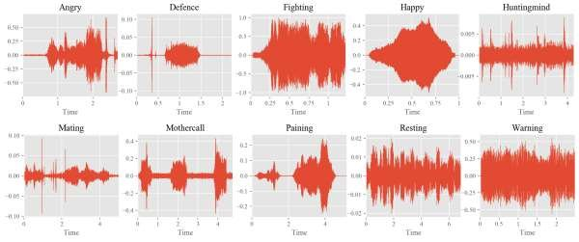
Waveform Visualization
Shows the amplitude of the audio signal over time. Helps in identifying loudness, silence, and temporal characteristics of the sound
24.5. Audio Visualization Techniques.

Slide 31
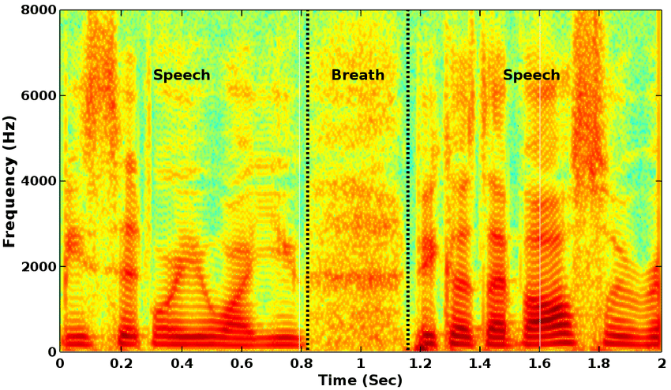
Spectrogram
Essential for analyzing the frequency content, identifying different sounds, and visualizing speech for recognition tasks
24.5. Audio Visualization Techniques.

Slide 32
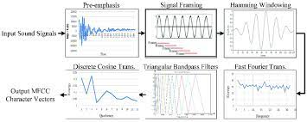
Mel-Frequency Cepstral Coefficients (MFCCs)
Represents the short-term power spectrum of sound. Widely used in speech and audio processing, especially in machine learning for feature extraction
24.5. Audio Visualization Techniques.

Slide 33
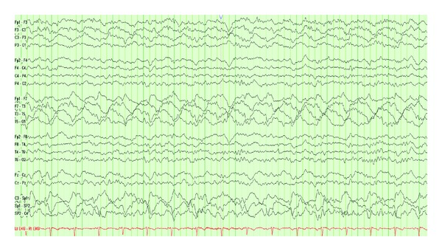
Temporal Rhythmic Analysis
Useful in music analysis for identifying rhythm patterns and beat tracking
24.5. Audio Visualization Techniques.

Slide 34
END.

